Slide 1
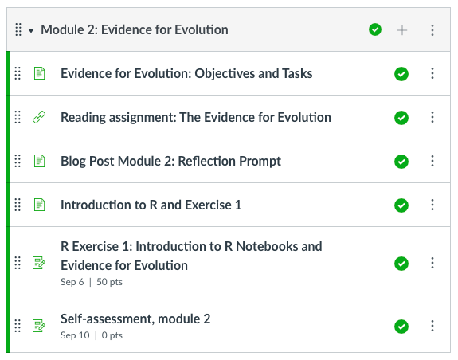
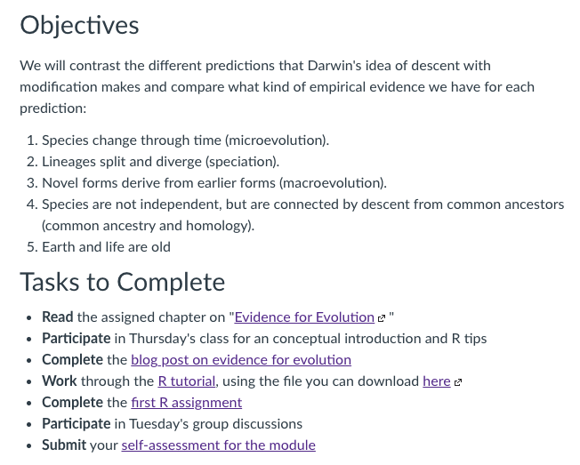
Evidence for evolution

Slide 2
Basic predictions of descent with modification
Species change through time (microevolution)
Lineages split and diverge (speciation)
Novel forms derive from earlier forms
Species are not independent, but are connected by descent from common ancestors
Earth and life are old
So, what is the evidence?

Slide 3
We can observe species change through time

Slide 4
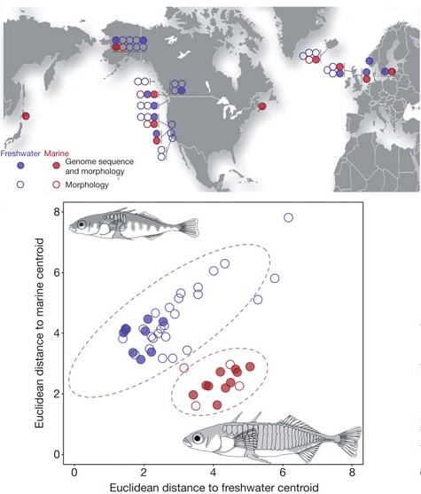
We can observe species change through time
Stickleback evolution upon freshwater colonization
Reduction is body armor and spines
Driven by reduction in predation and increases in costs
Evolved many times independently (in convergence)

Slide 5

We can observe species change through time
Stickleback evolution upon freshwater colonization
1964 Great Alaska Earthquake
Emily Lescak

Slide 6
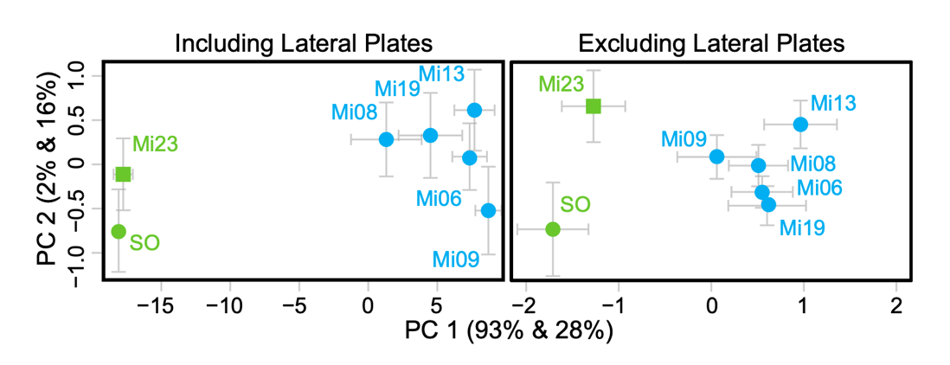
We can observe species change through time
Stickleback evolution upon freshwater colonization
1964 Great Alaska Earthquake
Uplift created new freshwater ponds on islands in the Prince William Sound
Freshwater forms evolved in <50 years!

Slide 7
The convergence of ecological and evolutionary times
Adaptive evolution of tolerance to anthropogenic pollution

Slide 8
We can catch lineages in the process of splitting

Slide 9
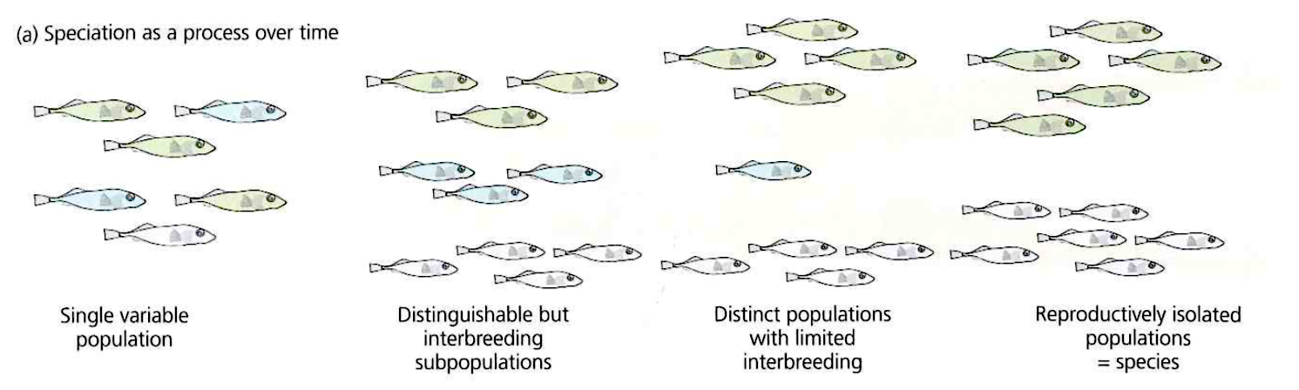
We can catch lineages in the process of splitting
Species are groups of populations among which individuals can interbreed, but outside of which they do not
Speciation is a gradual process during which population diverge to the point that they can no longer interbreed

Slide 10
We can catch lineages in the process of splitting
Ring species
Two populations which do not interbreed are living in the same region and connected by a geographic ring of populations that can interbreed

Slide 11
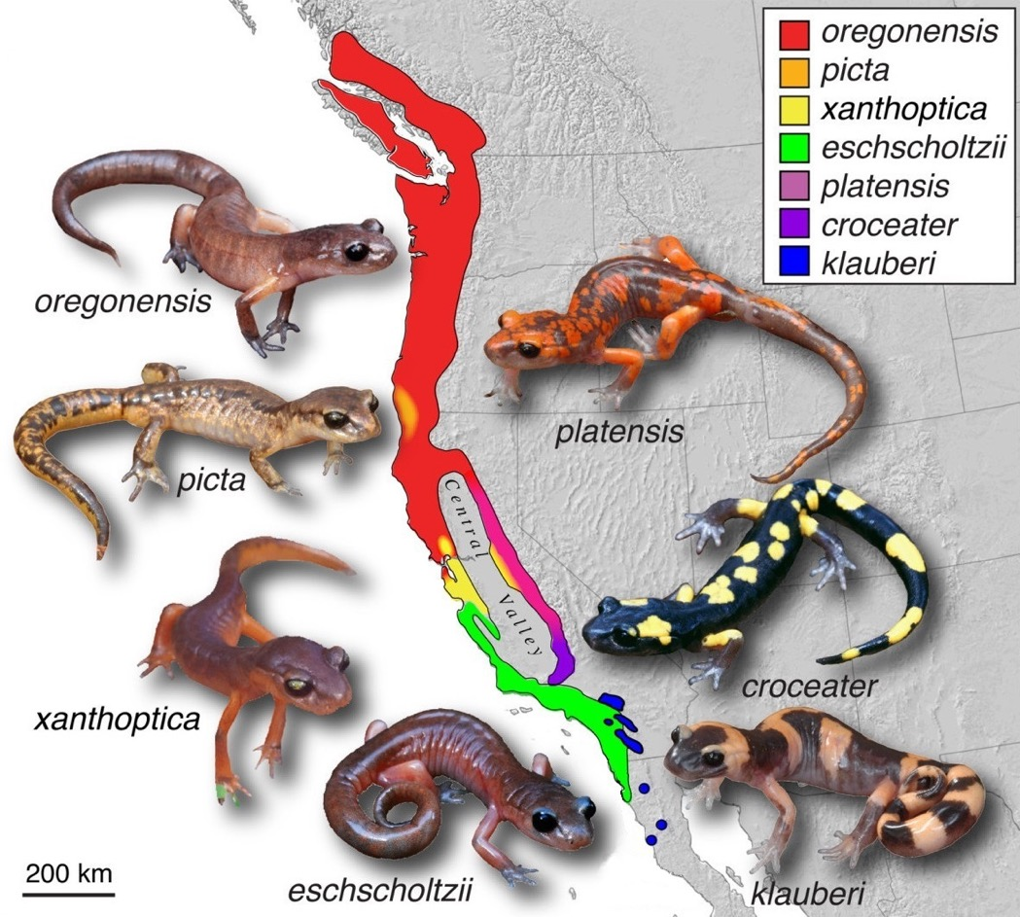
We can catch lineages in the process of splitting
Ring species
Two populations which do not interbreed are living in the same region and connected by a geographic ring of populations that can interbreed
Example: Ensatina salamanders

Slide 12
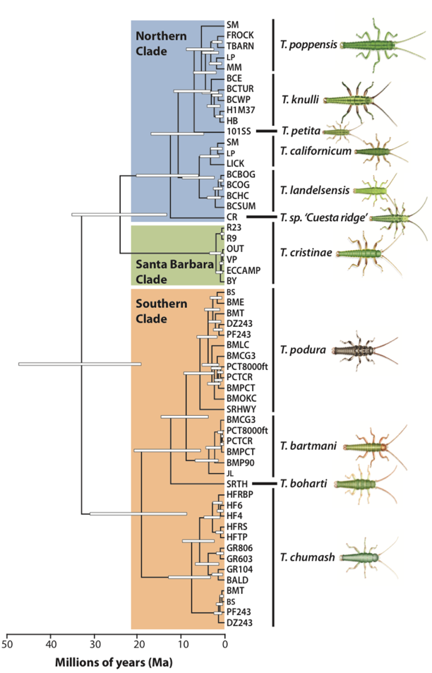
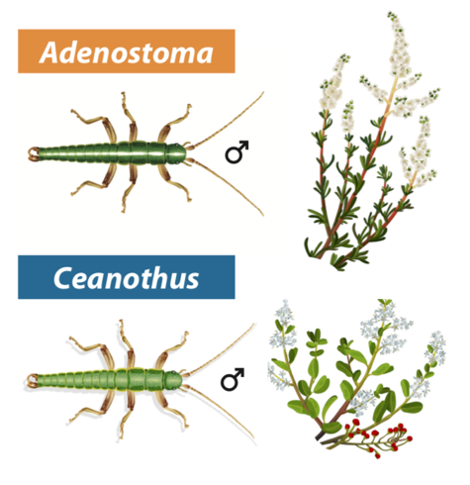
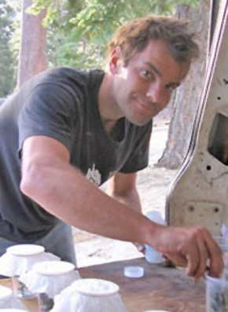
We can catch lineages in the process of splitting
In many natural populations, different stages along the speciation continuum can be observed
Example: Timema stick insects
Patrick Nosil

Slide 13
We have time series of evolutionary transitions

Slide 14
We have time series of evolutionary transitions
Fossils are not randomly distributed on the planet
Law of succession: correspondence between fossils and living forms at the same locale

Slide 15
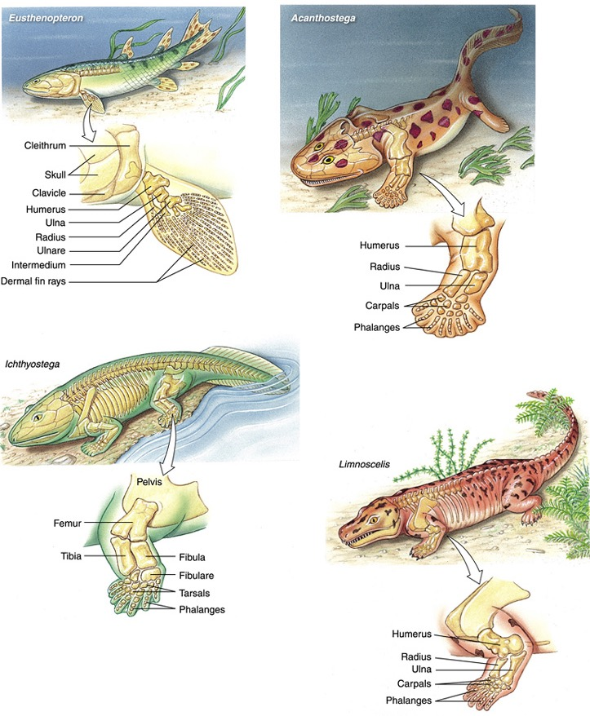
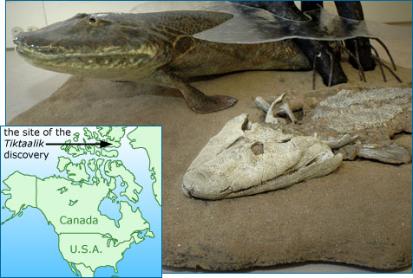
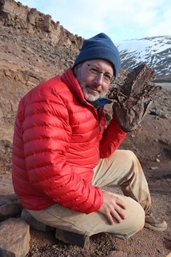
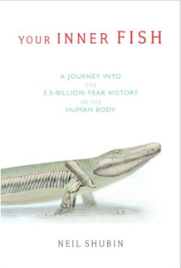
We have time series of evolutionary transitions
Fossils are not randomly distributed on the planet
Law of succession: correspondence between fossils and living forms at the same locale
Transitional fossils appear in a predictable order
Neil Shubin

Slide 16
We have evidence that species are connected

Slide 17
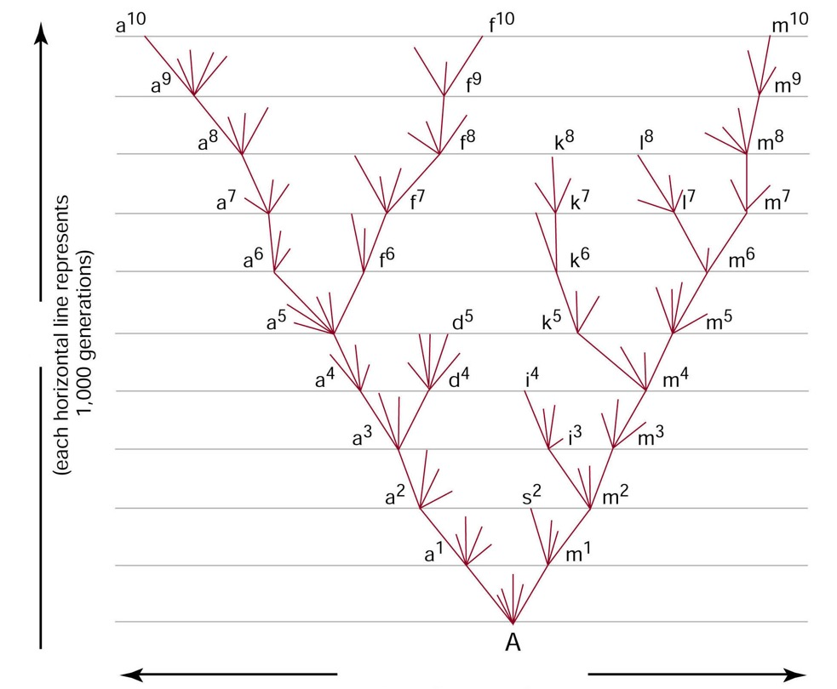
We have evidence that species are connected
Species are connected through common ancestors
Phylogenetic trees are representations of this connectedness

Slide 18
We have evidence that species are connected
Shared ancestry of traits in different taxa (homology)
As opposed analogous structures that are similar but phylogenetically independent)

Slide 19
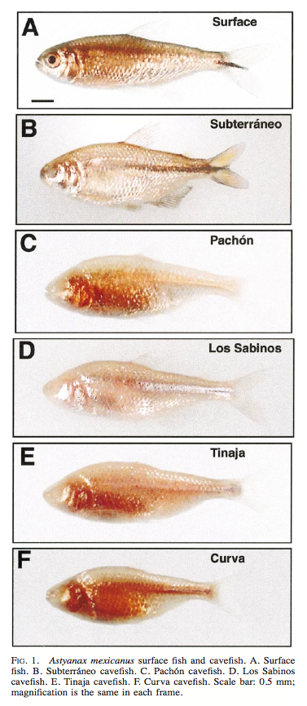
We have evidence that species are connected
Shared ancestry of traits in different taxa (homology)
Example: Vestigial organs (functionless or rudimentary traits that have a function in a close relative)

Slide 20
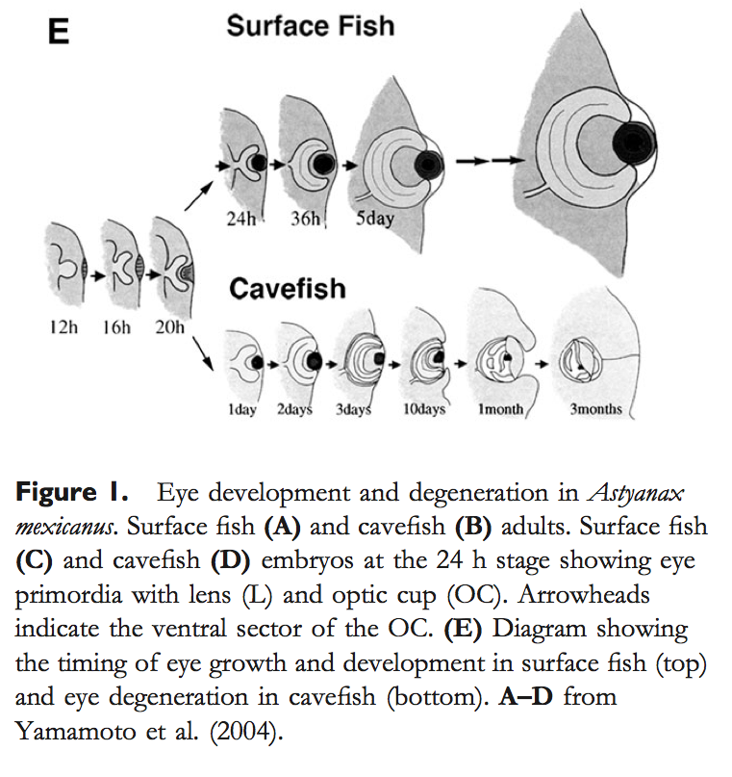
We have evidence that species are connected
Shared ancestry of traits in different taxa (homology)
Example: Vestigial organs (functionless or rudimentary traits that have a function in a close relative)
Vestigial organs can be structural or developmental

Slide 21
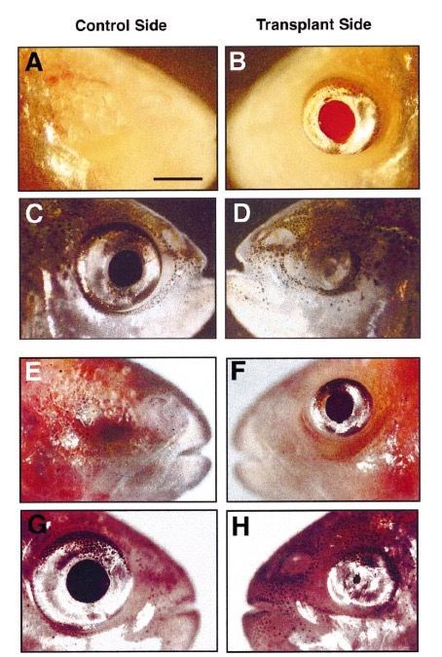
We have evidence that species are connected
Shared ancestry of traits in different taxa (homology)
Example: Vestigial organs (functionless or rudimentary traits that have a function in a close relative)
Vestigial organs can be structural or developmental
Underlying genes are still present

Slide 22
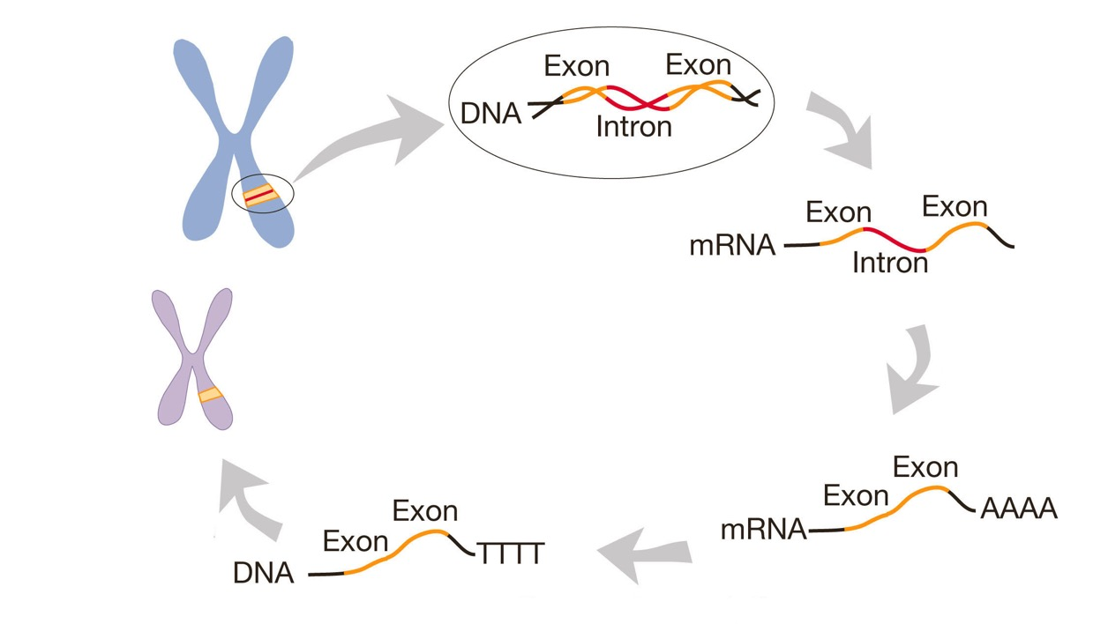
We have evidence that species are connected
Shared ancestry of traits in different taxa (homology)
Example: Pseudogenes
Pseudogenes arise when processed messenger RNA is reverse transcribed and inserted into the genome

Slide 23
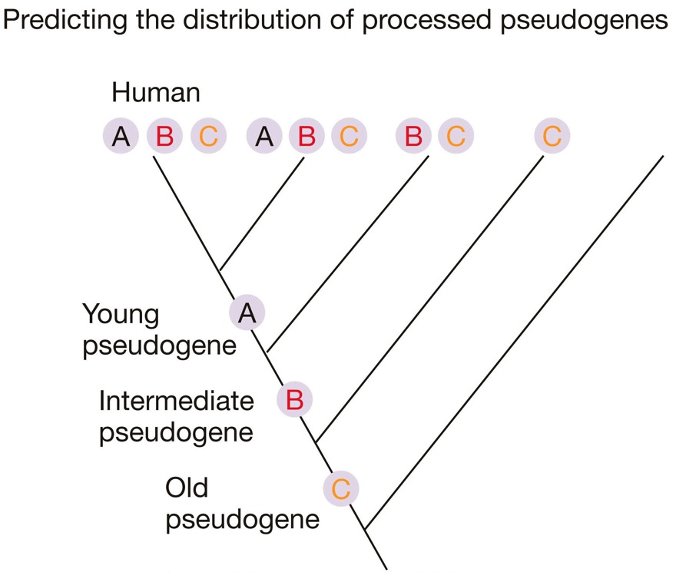
We have evidence that species are connected
Shared ancestry of traits in different taxa (homology)
Example: Pseudogenes
Pseudogenes arise when processed messenger RNA is reverse transcribed and inserted into the genome
Since pseudogenes have no function in the genome, mutations accumulate over time
If organisms stem from a common ancestor, older pseudogenes should occur in a broader range of species

Slide 24
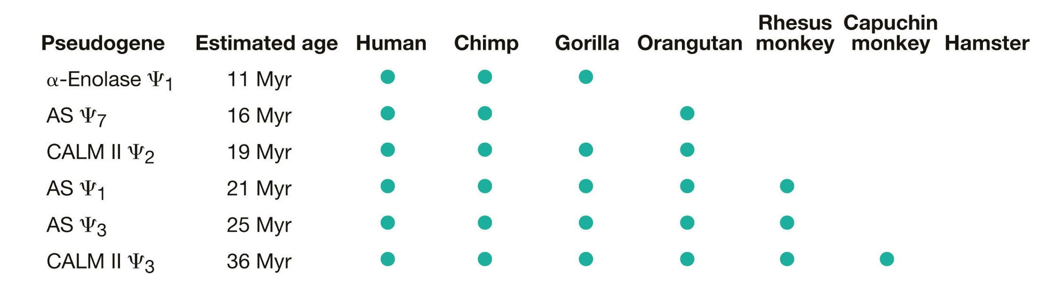
We have evidence that species are connected
Shared ancestry of traits in different taxa (homology)
Example: Pseudogenes

Slide 25
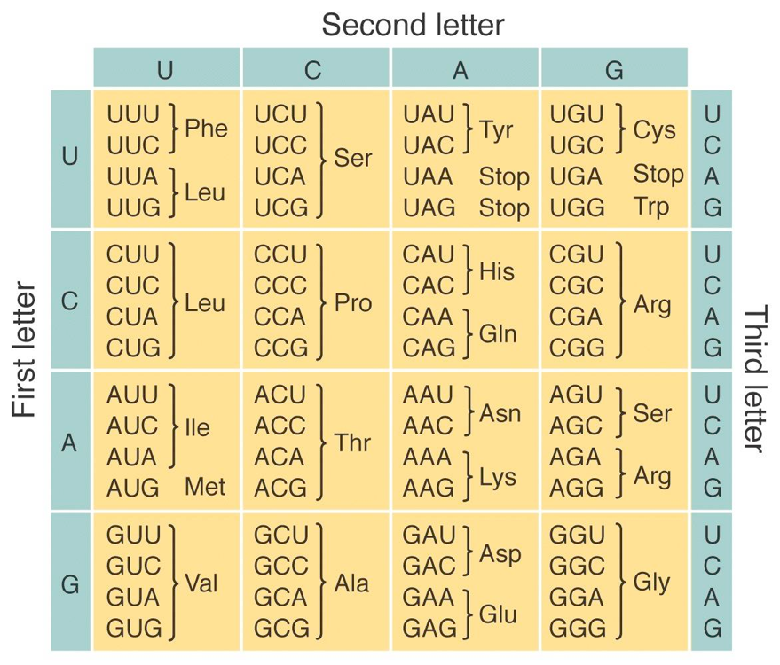
We have evidence that species are connected
Shared ancestry of traits in different taxa (homology)
Homologies occur at multiple levels (from genes to morphological structures)
Homologies occur in a nested fashion (closely related species share a higher number of homologies)

Slide 26
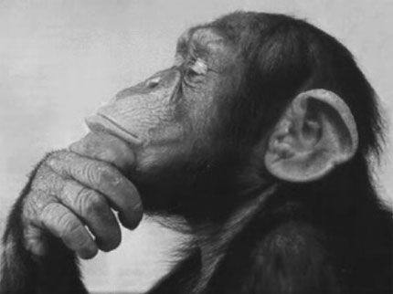
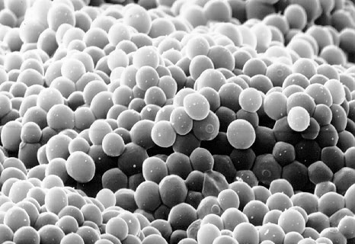
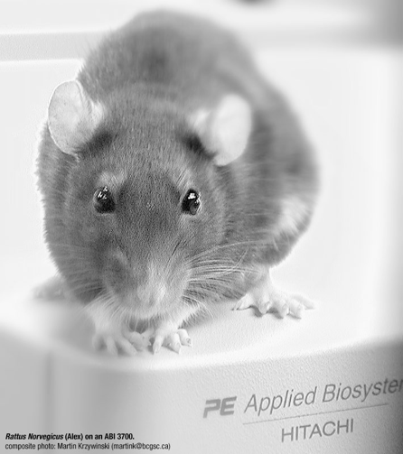
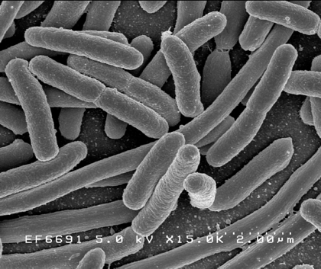
We have evidence that species are connected
Shared ancestry of traits in different taxa (homology)
Homologies occur at multiple levels (from genes to morphological structures)
Homologies occur in a nested fashion (closely related species share a higher number of homologies)
Psychiatry & behavior
Cell cycle
Response to drugs
DNA repair

